Slide 1
How to work with an LLM
Utilize ChatGPT on your own data
Manuel Juran

Slide 2
Chatbot Example
Chat with Data!
TechTalkGPT
Wikipedia Page Chatbot

Slide 3
The sky is …
blue
Notes:
Alternativ: Be ambitious. The sky is … / The grass is green and the sky is …

Slide 4
The sky is the …
limit

Slide 5
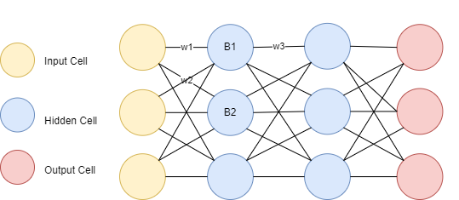
Neural Network Architecture

Slide 6

How does an LLM work?
Chat
Roles: System, Assistent, User
Finetuning
Completion
The sky is
blue
Generative Pretrained Transformer
Token
Token
< Token limit
Prompt
Inference
Response
Temperature
Default: non-deterministic hallucinates
Grounding (RAG)
Embeddings
Knowledge-Base

Slide 7

LLM breakthroughs
Limited Modelsize
Limited Context Knowledge
Hardly scalable
Entwicklung von LLMs
1. Size of Network (=Parameter) 2. Training data (Number and Quality)
2017: Transformer Architecture
2022: ChatGPT
1990: RNN
1998: CNN
1997: LSTM
Paper: Attention is all you need
2018: Open-AI GPT-1
2018: Google BERT
2019: Meta RoBERTA
2019: Google T5
2019: Open-AI GPT-2
2020: Google ELECTRA
2020: Open-AI GPT-3
Notes:
Todo CH: Limit 1 Minute / Animation
Größere und mächtigere Modelle waren immer das Ziel, aber erst durch TA möglich wegen
1990: RNN: Recurrent Neural Networks (1997 LSTM Sepp Hochreiter)
1998: CNN: Convolutional Neural Networks
2017: "Attention is All You Need“ (Google Research/Brain)
2018: Open-AI GPT-1: Generative Pretrained Transformer
2018: Google BERT: Bidirectional Encoder Representation from Transformers
2019: Meta RoBERTA: A Robustly Optimized BERT Pretraining Approach
2019: Google T5: Text-to-Text Transfer Transformer
2020: Open-AI: GPT3
2020: Google ELECTRA (Efficiently Learning an Encoder that Classifies Token Replacements Accurately)
November 2022: Open AI: ChatGPT (basierend auf GPT3.5)

Slide 8
Hyperparameter
What does “7B Parameter” mean?
Weights & Biases
Specialties of Transformer Architecture:
Attention Mechanisms
Focus on specific parts of sentences
Parallelism
All input at once
=> Training way more performant

Slide 9
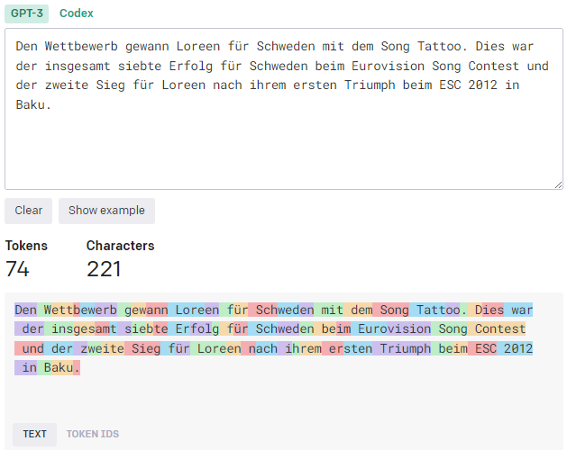
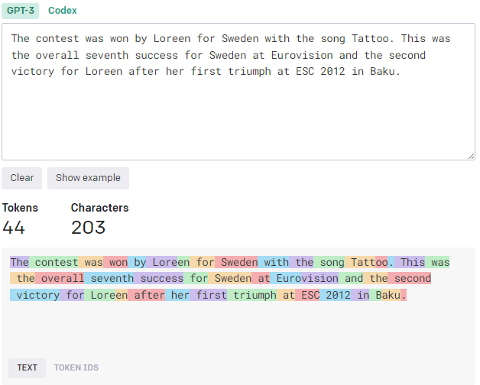
Tokenization
Tokenizer of LLM fragments text into unique word(segments)
-> Numbers

Slide 10
Index
Embedding
Vector(Point) in semantic space
Learned meaning of a given text (word, sentence,documents)
Emb(‘King’) - Emb(’Man’) + Emb(Woman’) = Emb(’Queen’)
Usage
Persistence → VectorDB
Search with distance
Notes:
Struktur <-> Bedeutung

Slide 11
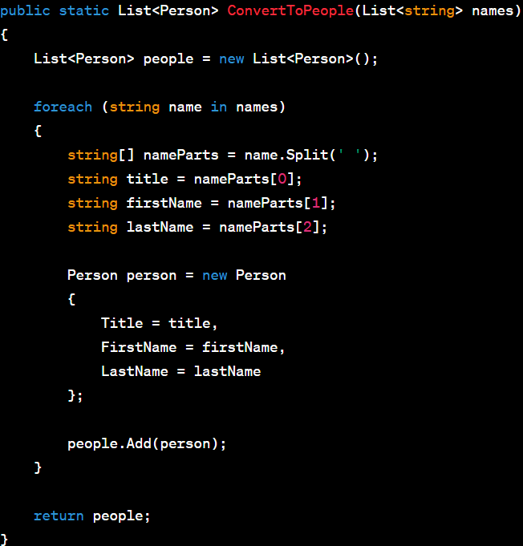
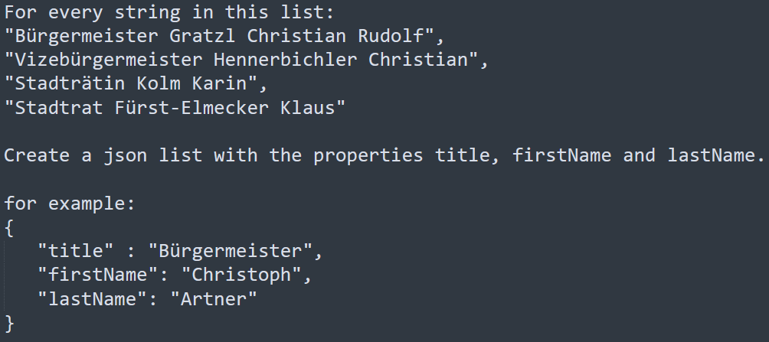
Index
Syntactic
Semantic

Slide 12
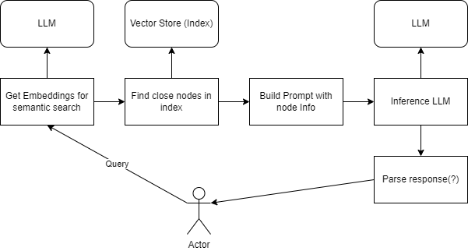
Retrieval Augmented Generation

Slide 13
Prompt Engineering
English: How do you reset your password?
Spanish:
Para resetear tu contraseña, ve a la página de inicio de sesión de la aplicación y haz clic en el enlace "Olvidé mi contraseña". Se te enviará un correo electrónico con instrucciones para restablecer tu contraseña.
Translate.
English: How do you reset your password?
Spanish:
¿Cómo restablecer su contraseña?

Slide 14
Prompt Engineering
Don’t be afraid of longer prompts
List examples
Give the model time to think
Fe: instruct model to generate intermediate steps
Ask for reasoning
Use delimiters (---, ´´´, .. )
Easy to understand prompts
One Task per prompt
2 Modi:
Chat (Question/Task -> Answer)
Completion (‘The following is a list of attendees:’)

Slide 15
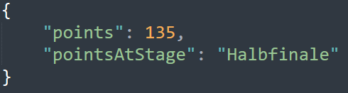
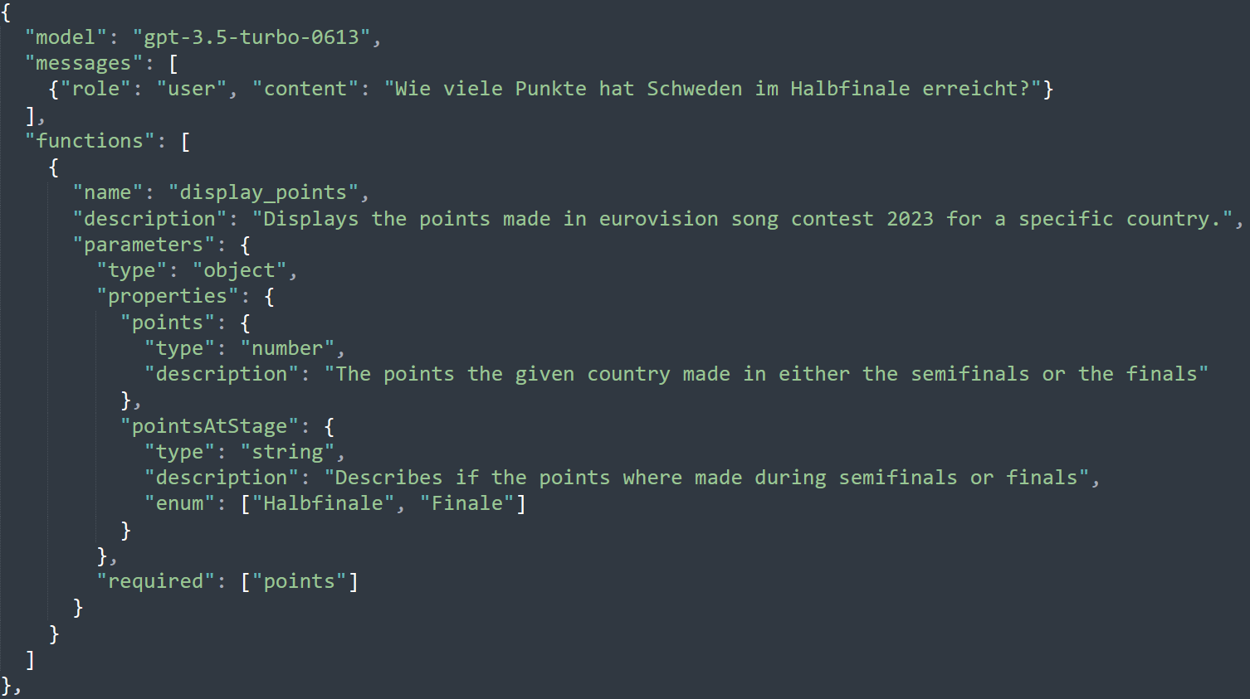
How can we parse results?
Just tell it your desired output format
Careful – error resistant parsing!
Function Calling

Slide 16
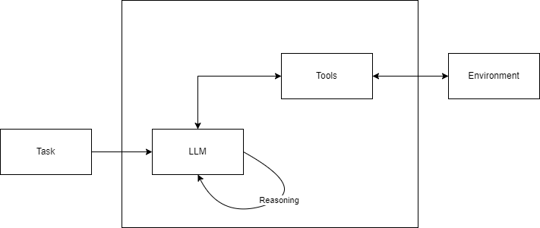
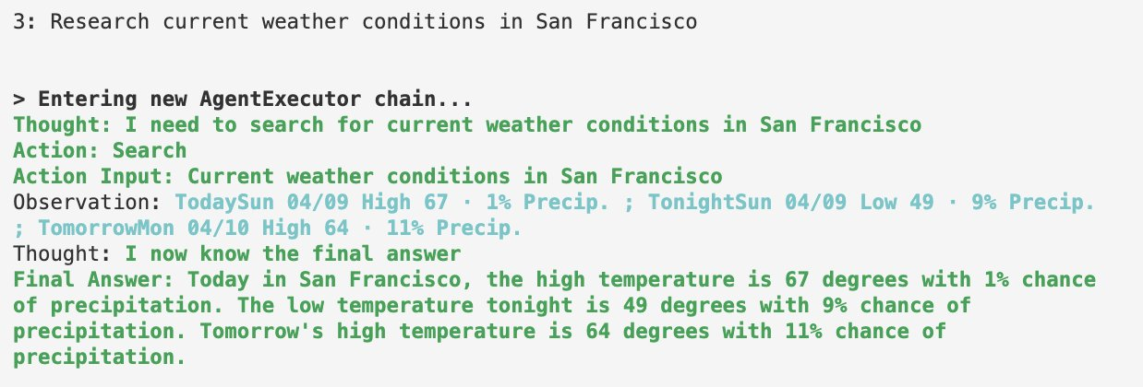
The future: Agents
Expose tools to llm
Let llm decide what to do
In a loop until we can formulate answer

Slide 17
Prompt Eval & Regression Testing
Evaluation with
Rigid results (fe when classifying)
Other LLMs

Slide 18
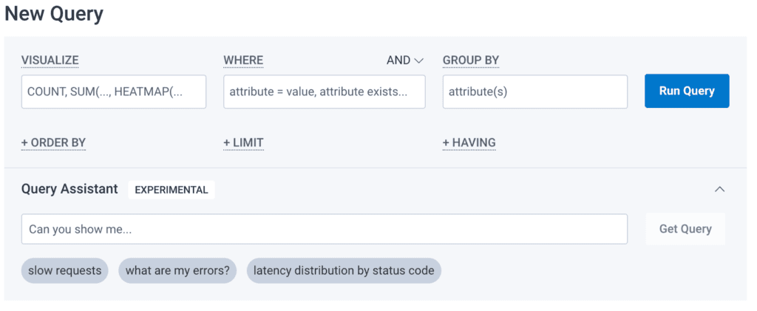
Key Challenges
Technical Topics
Find correct context in index
Data quality
On Premise vs Hosted Model (GPDR)
Sensitive to changes in prompt
Performance
Domain Topics
Prompt Engineering
How to split context
User Interface changes
Output does not have to be plain text

Slide 19
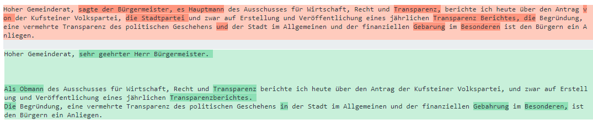
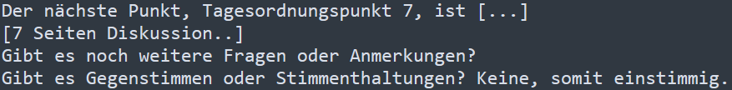
Key Challenges

Slide 20
TechStack Example
Python modules:
(Llama_index)
LangChain
OpenAi
Pypdf
(Azure)OpenAI
Embedding Model
Chat/Completion Model

Slide 21
Demo in Notebook
Jupyter Notebooks
VS Code extensions
Pylance + Python
Jupyter
Polyglot Notebooks
.NET Example with RAG + Semantic Kernel
https://github.com/Azure-Samples/semantic-kernel-rag-chat/tree/main
Notes:
https://github.com/Azure-Samples/semantic-kernel-rag-chat/tree/main

Slide 22
What do we not need LLMs for?
Its about augmentation, not autopiloting
Syntactic/simple problems
No rigid structure
Zb: R#er vs Github Copilot, „Whats 30+12?“

Slide 23
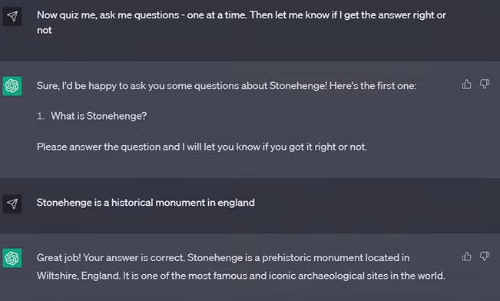
What should we use LLMs for?
In general
Semantic Tasks, capture meaning from texts
Generate text according with specific meaning or patterns
Natural language API for users, extract semantic meaning
User handbook ChatBot
Summaries
Take Quizzes
No Multiple Choice
Commands in natural language
Transformation:
Translation
Write code

